Slide 1

Learning
001
SPARQL
(opening & intro)
Author: Bob DuCharme
Xiaoqi Zhao, GitHub: https://github.com/yasenstar/Learn_SPARQL

Slide 2
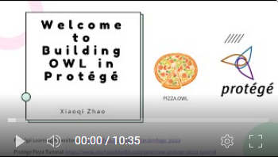
Opening & Intro
About the Book
Learning Notes and Practical Code – GitHub (& Gitee)
https://github.com/yasenstar/Learn_SPARQL
https://gitee.com/yasenstar/Learn_SPARQL
Mindmap – by FreePlane
Video series – to be added to YouTube (and others)
Reference Videos: Ontology Practice – pizza.owl by Protege

Slide 3
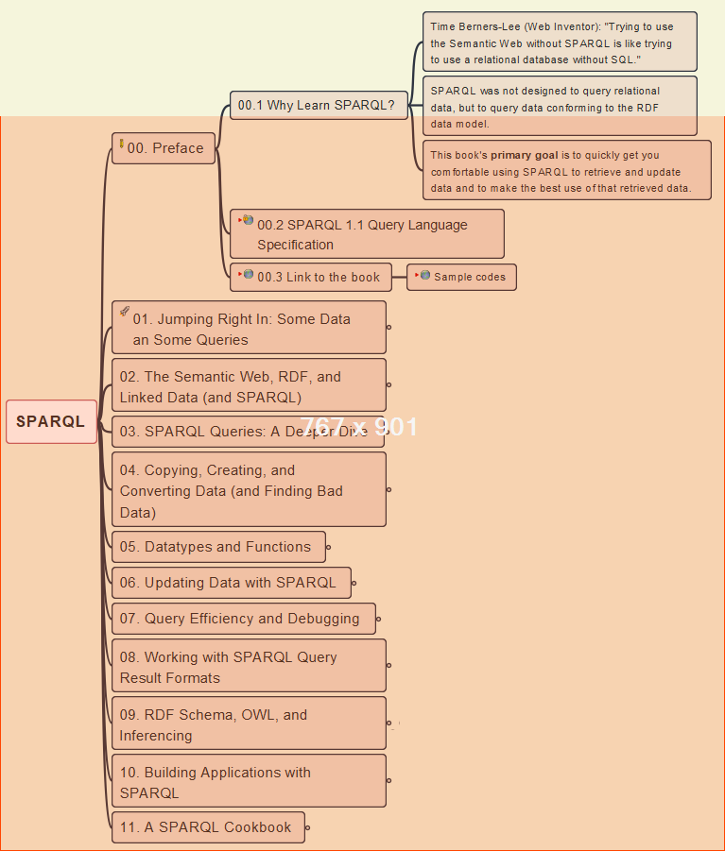
00- Preface
002
Why SPARQL and Resources

Slide 4
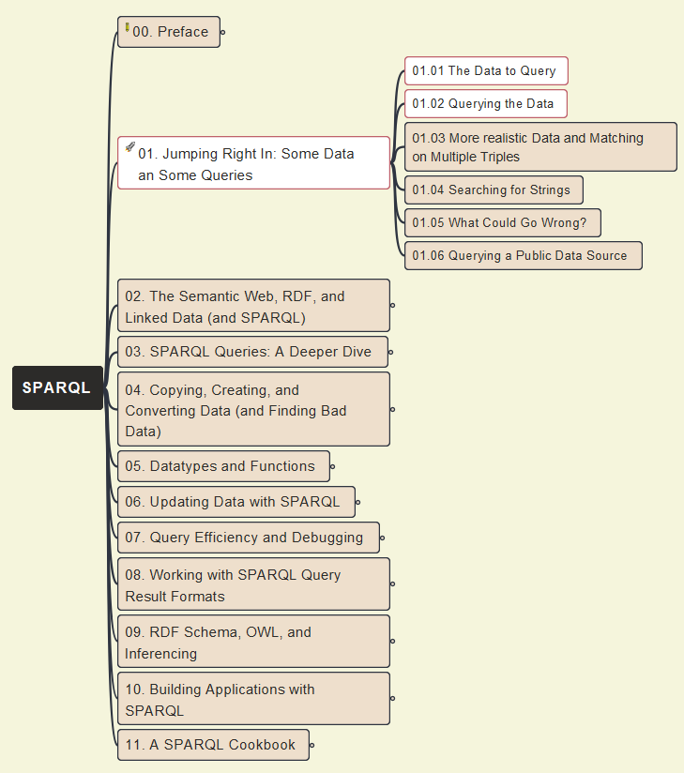
01- Jumping Right In
003
Initial Data Query and Jena (ARQ) Tool

Slide 5
01- Jumping Right In
004
Initial Data Query (cont.)

Slide 6

01- Jumping Right In
005
Initial Data Query (cont.): use Protégé to Query Data

Slide 7
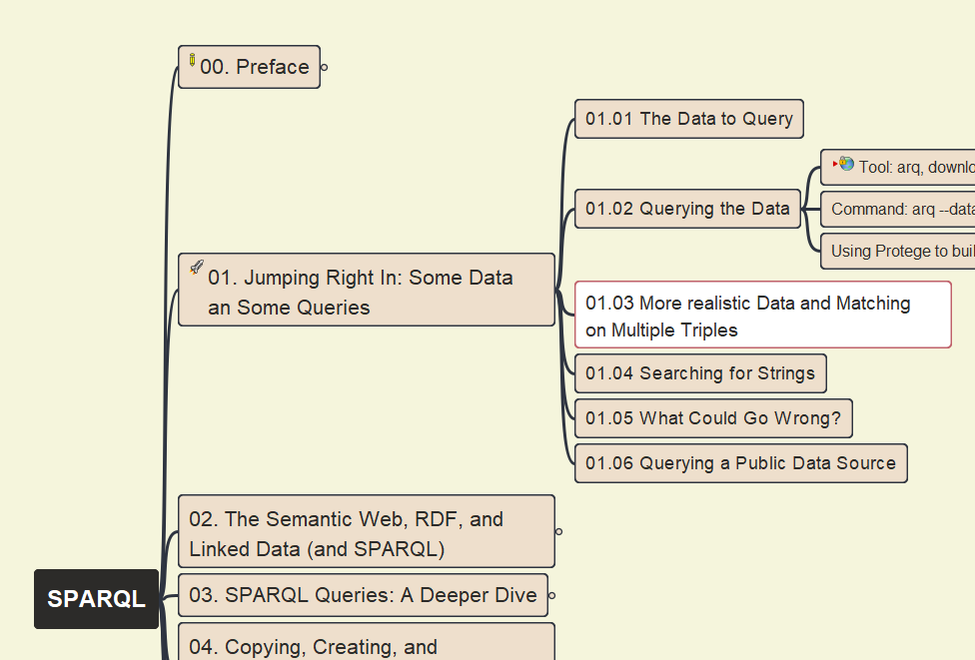
01- Jumping Right In
006
More Realistic Data and Matching on Multiple Triples

Slide 8
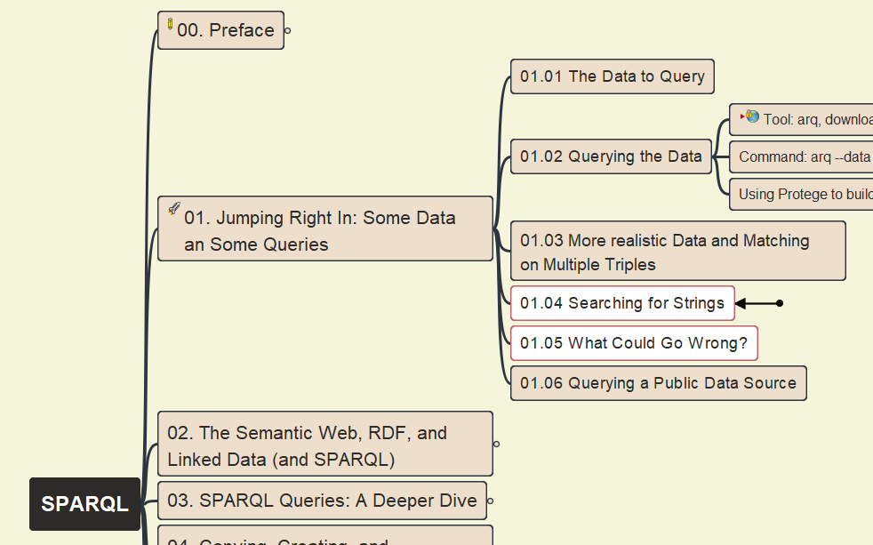
01- Jumping Right In
007
01.04 Searching for Strings
01.05 What Could Go Wrong?

Slide 9
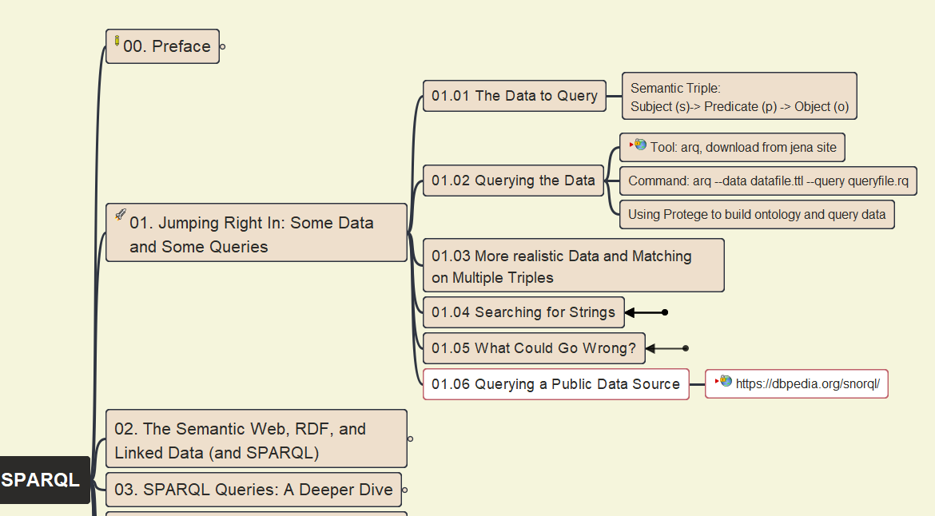
01- Jumping Right In
008
01.06 Querying Public Data Source

Slide 10
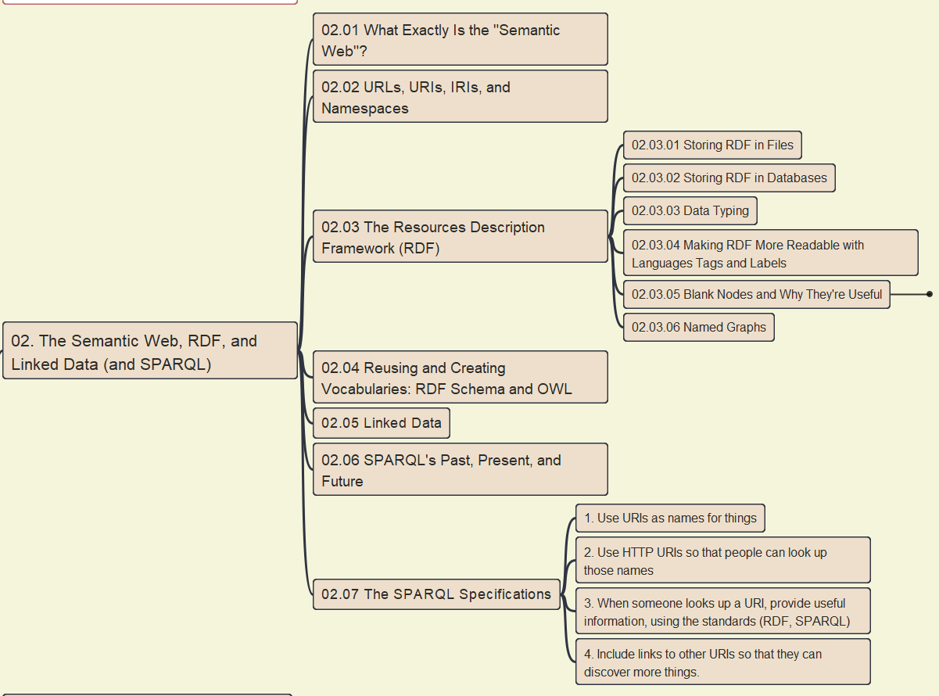
02- The Semantic Web, RDF, Linked Data (& SPARQL)
009
02.01 What is Semantic Web?

Slide 11
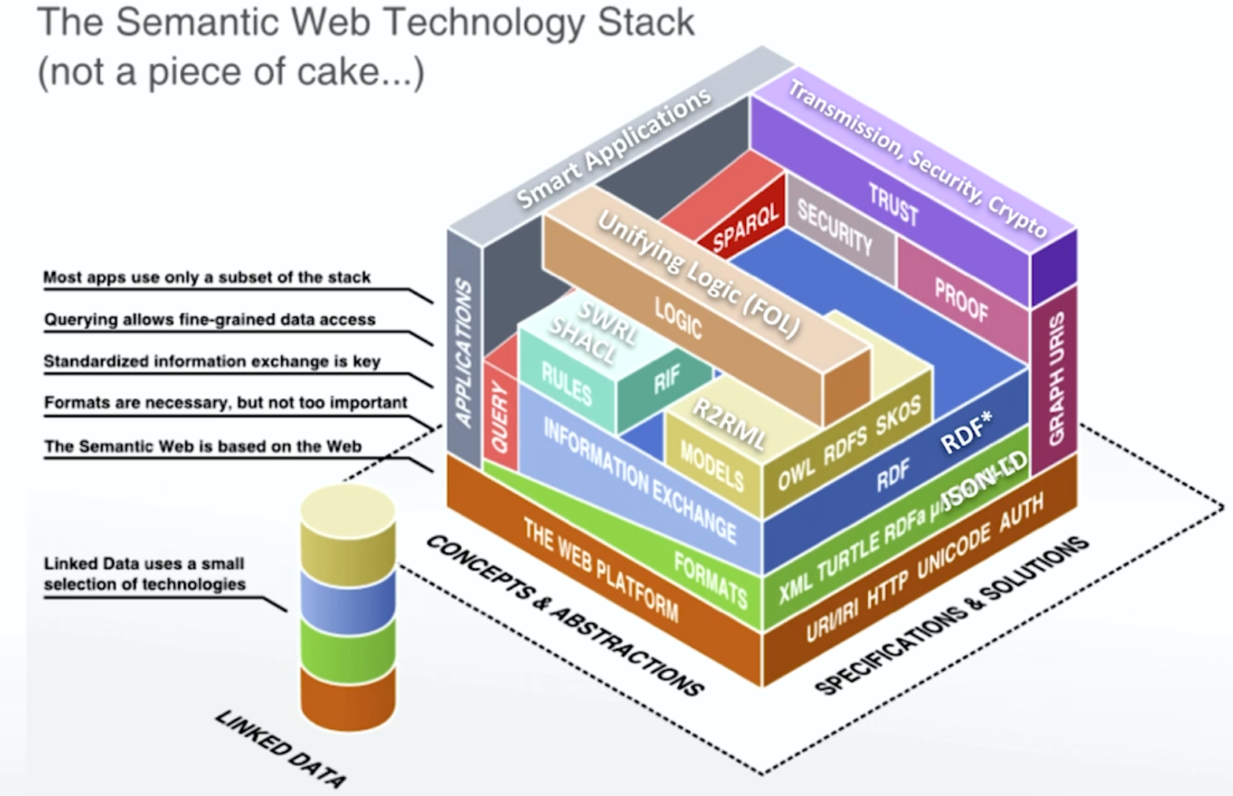
The Semantic Web Technology Stack
Source: OpenHPI training

Slide 12
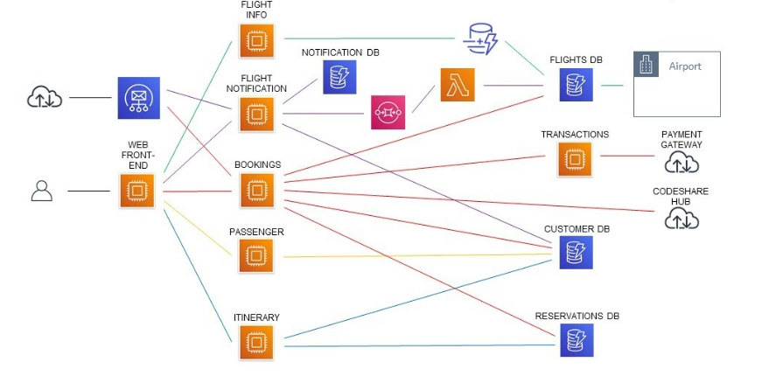
Airline Reservation System – Sample Architecture
Source: https://www.youtube.com/watch?v=bV1_R4XQZDY

Slide 13
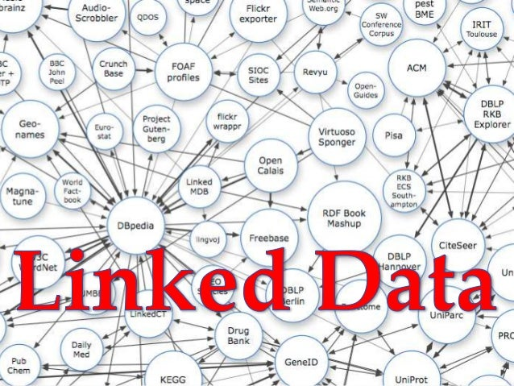
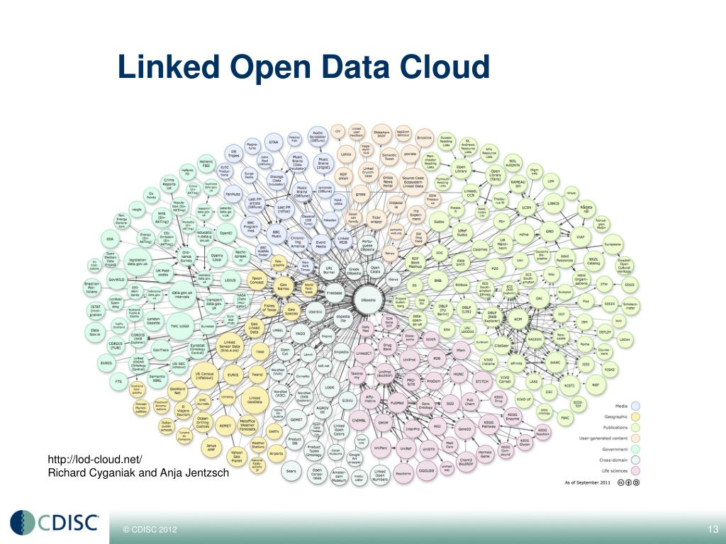
Linked Data – Best Practices

Slide 14
02- The Semantic Web, RDF, Linked Data (& SPARQL)
010
02.02 URLs, URIs, IRIs, and Namespaces

Slide 15
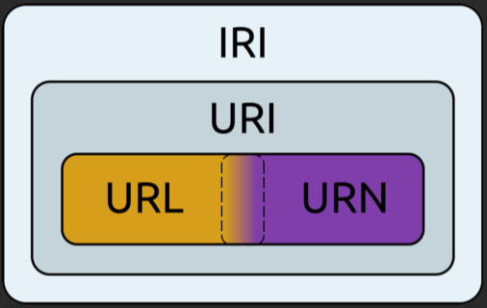
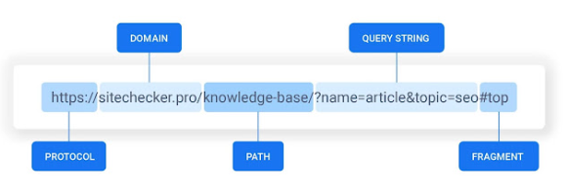
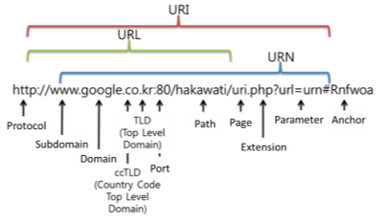
Relationship: URL/URN, URI, IRI
Structure of the URL:
URL: Uniform Resource Locator
URN: Universal Resource Names
URI: Uniform Resource Identifier
IRI: Internationalized Resource Identifier

Slide 16
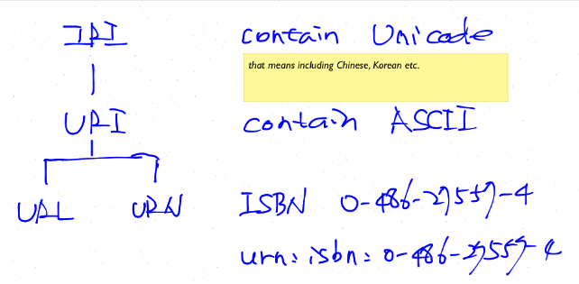
Data Story: IRI, URI, URL and URN
URL: Uniform Resource Locator, usually using specific protocols to locate resource within World Wide Web is the most common type of URI.
URN: Universal Resource Names, one of the URI type with urn:scheme and the typical use example is ISBN system.
URI: Uniform Resource Identifier, includes URL and URN.
IRI: Internationalized Resource Identifier, compare to URI, it's characters are Unicode which means including Chinese, Japanese and Koreans etc.
Source: https://parklize.blogspot.com/2014/05/iri-uri-url-and-urn.html

